Slide 1
Capstone Project : 3 on
Credit Card Default Prediction by Raushan kumar

Slide 2
Contents
Problem Description
Dataset Information and Summary
Description of Features
Data Preprocessing & Data Cleaning
Exploratory Data Analysis
Model Preparation
Algorithm used
Model performance
Hyperparameter tunning
Overall Model Evaluation & Recommendation
Conclusions

Slide 3
Problem Description :
This project is aimed at predicting the case of customers default payments in Taiwan. From the perspective of risk management, the result of predictive accuracy of the estimated probability of default will be more valuable than the binary result of classification - credible or not credible clients. We can use the K-S chart to evaluate which customers will default on their credit card payments.

Slide 4
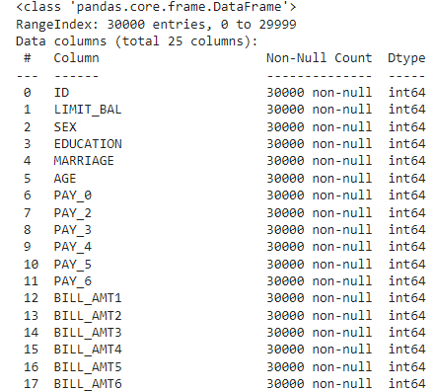
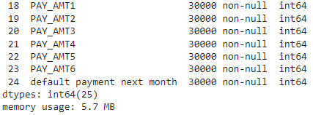
Dataset Information & Summary
The dataset has 30000 observations and 25 features.
This dataset is from the city of Taiwan and doesn’t have any null values.
default payment next month is our target variable.

Slide 5
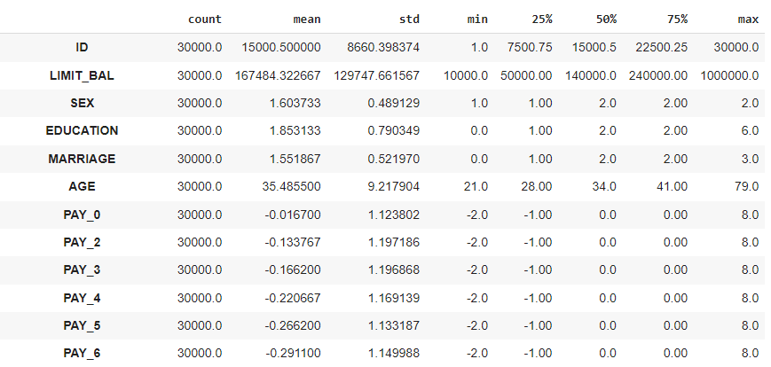
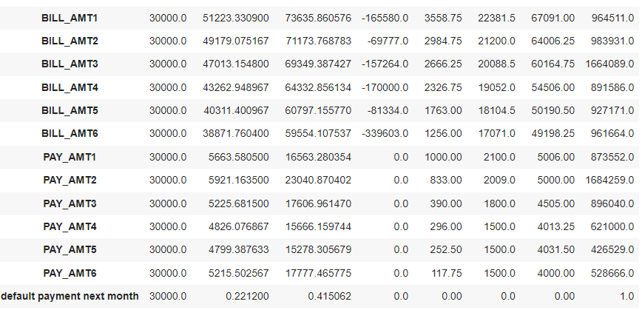
Description of Features :
Breakdown of Our Features:
We have records of 30000 customers. Below are the description of all features we have.
ID: ID of each client
LIMIT_BAL: Amount of given credit in NT dollars (includes individual and family/supplementary credit)
SEX: Gender (1 = male, 2 = female)
EDUCATION: (1 = graduate school, 2 = university, 3 = high school, 0,4,5,6 = others)
MARRIAGE: Marital status (0 = others, 1 = married, 2 = single, 3 = others)
AGE: Age in years

Slide 6
Scale for PAY_0 to PAY_6 : (-2 = No consumption, -1 = paid in full, 0 = use of revolving credit (paid minimum only), 1 = payment delay for one month, 2 = payment delay for two months, ... 8 = payment delay for eight months, 9 = payment delay for nine months and above)
PAY_0: Repayment status in September, 2005 (scale same as above)
PAY_2: Repayment status in August, 2005 (scale same as above)
PAY_3: Repayment status in July, 2005 (scale same as above)
PAY_4: Repayment status in June, 2005 (scale same as above)
PAY_5: Repayment status in May, 2005 (scale same as above)
PAY_6: Repayment status in April, 2005 (scale same as above
) BILL_AMT1: Amount of bill statement in September, 2005 (NT dollar)
BILL_AMT2: Amount of bill statement in August, 2005 (NT dollar)
BILL_AMT3: Amount of bill statement in July, 2005 (NT dollar)
BILL_AMT4: Amount of bill statement in June, 2005 (NT dollar)
BILL_AMT5: Amount of bill statement in May, 2005 (NT dollar)
BILL_AMT6: Amount of bill statement in April, 2005 (NT dollar)
PAY_AMT1: Amount of previous payment in September, 2005 (NT dollar)
PAY_AMT2: Amount of previous payment in August, 2005 (NT dollar)
PAY_AMT3: Amount of previous payment in July, 2005 (NT dollar)
PAY_AMT4: Amount of previous payment in June, 2005 (NT dollar)
PAY_AMT5: Amount of previous payment in May, 2005 (NT dollar)
PAY_AMT6: Amount of previous payment in April, 2005 (NT dollar)
default.payment.next.month: Default payment (1=yes, 0=no)

Slide 7
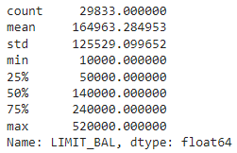
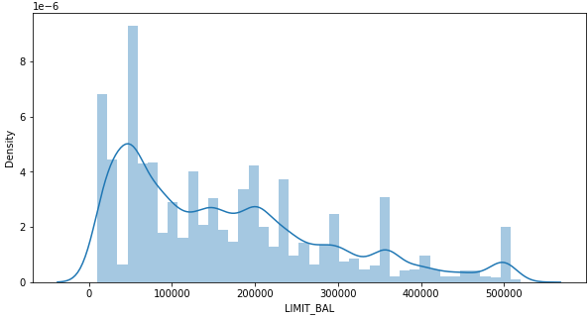
Data Preprocessing & Data Cleaning
There are no duplicate and null values present in our dataset
There is presence of some outliers, and we have to remove them.
The Descriptive analysis & distribution plot of “LIMIT_BAL”‘ after outliers removal is:-
The Maximum amount of given credit in New Taiwan dollars(NT-💲) is near about 50,000 followed by 30,000 and 20,000 .

Slide 8
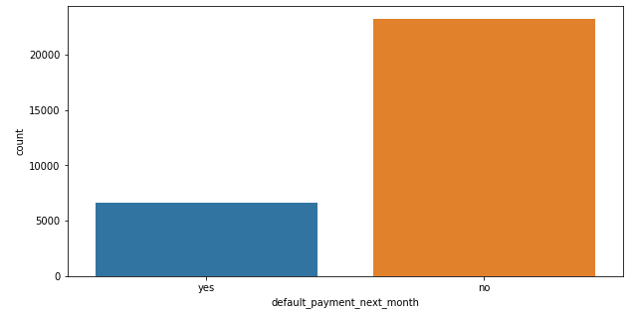
Exploratory Data Analysis
0 - Not Default – No
1 - Default – Yes
Defaulters are less than the Non Defaulters in the given dataset.
On getting the proportion of customers who had default payment in the next month, we observed that about 22% customers had default payment next month

Slide 9
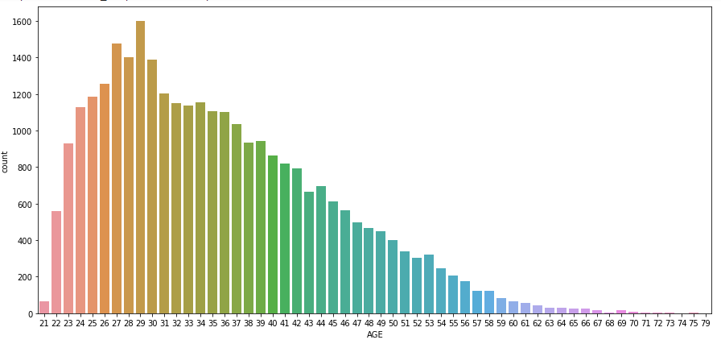
Number of ages of people with credit card
From this count-plot, we can say that people from age 24 to 36 uses more credit card. Above 60 years of age people rarely use credit card.

Slide 10
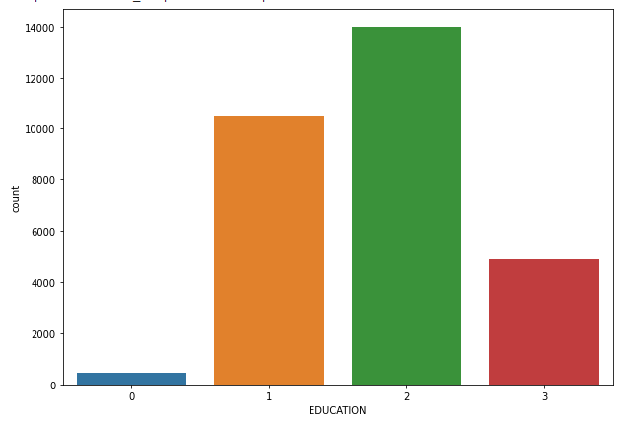
Number of credit card on the basis of Education
1 = graduate school; 2 = university; 3 = high school; 0 = others.
On the basis of above analysis and visualization, we can conclude that most number of credit card holders are university students.

Slide 11
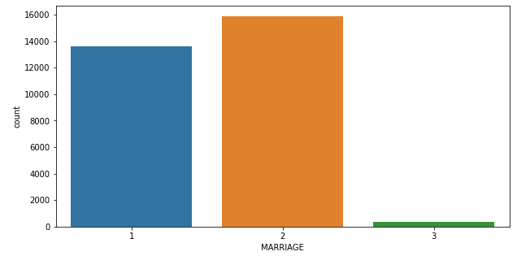
Number of credit card on the basis of Marital status
1 = married
2 = single
3 = others
From this plot we can see that most number of credit card are hold by people whose marriage status is single.

Slide 12
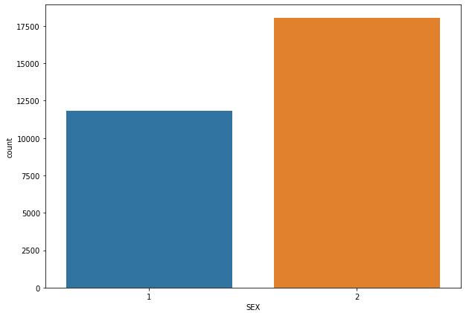
Number of credit card on the basis of Gender
1: Male
2: Female
From this plot we can conclude that number of female credit card holder are more than male.

Slide 13
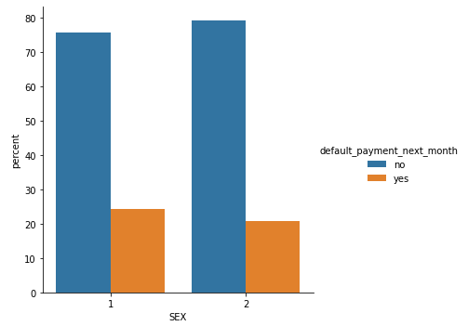
Sex and default_payment_next_month
It is evident from the above plot that Males have more default payment as compared to Females.
1: Male
2: Female

Slide 14
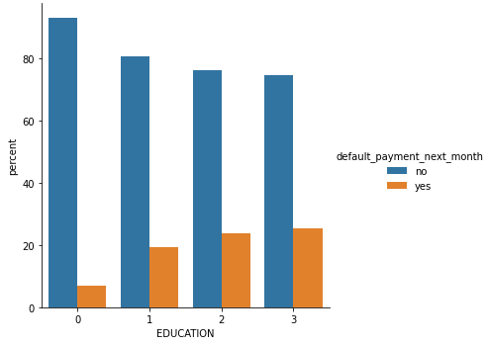
Education and default_payment_next_month
1 = graduate school; 2 = university; 3 = high school; 0 = others.
From this plot, we can see that high schools people has more default payment than others.

Slide 15
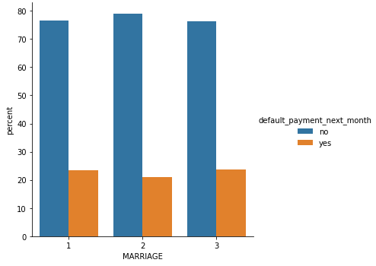
Marriage and default_payment_next_month
1 = married
2 = single
3 = others
High Default payment in others category are more as compared to married and single.

Slide 16
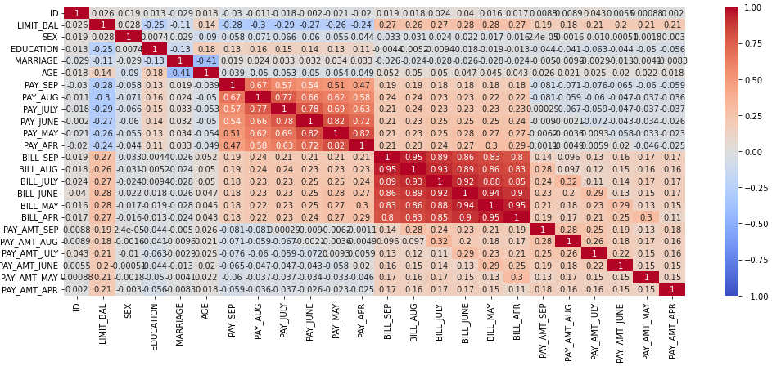
Correlation Matrix
Some variable like age are negatively correlated, but we can't blindly remove this feature as it could be important feature for prediction, whereas ID is not important and it has no role in prediction so we will remove it in further process.

Slide 17
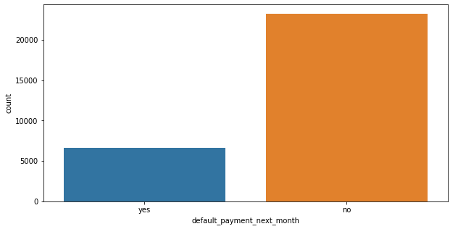
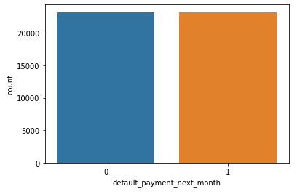
SMOTE(Synthetic Minority Oversampling Technique)
In our dataset we have high imbalanced data distribution in target variable, this happens generally when observation in one of the class are much higher.
Thus, we need a method which . aims to balance class distribution by randomly increasing minority class examples by replicating them.
SMOTE is one such method used to solve the imbalance problem.
0 - Not Default - No
1 - Default – Yes
The above graph is before SMOTE while below is after SMOTE.

Slide 18

Machine Learning Model – Classification

Slide 19
Machine Learning Models / Algorithms Used
Logistic Regression
XG Boost Classifier
Random Forest Classifier
Support Vector Classifier (SVC)

Slide 20
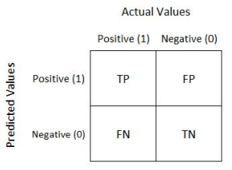
Performance / Confusion Metrics
Confusion matrix is a performance measurement for machine learning
classification problem where output can be two or more classes.
It is a table with 4 different combinations of predicted and actual values.
Accuracy = (TP+TN) / (TP+FP+TN+FN)
Precision is a good metric to use when the costs of false positive(FP) is high.
Precision = TP / (TP + FP)
Recall is a good metric to use when the cost associated with false negative(FN) is high.
Recall = TP / (TP + FN)
F1-score is a weighted average of precision and recall. Thus, it considers FP and FN. This metric is very useful when we have uneven class distribution, as it seeks a balance between precision and recall.
F1-score = 2 (precision recall) / (precision + recall)

Slide 21
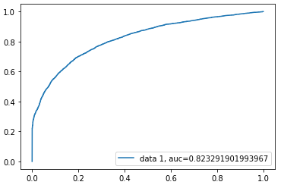

Logistic Regression
Logistic Regression is one of the simplest algorithms which estimates the relationship between one dependent binary variable and independent variables, computing the probability of occurrence of an event. The regulation parameter C controls the trade-off between increasing complexity (over fitting) and keeping the model simple (under fitting). For large values of C, the power of regulation is reduced and the model increases its complexity, thus over fitting the data.
Best Parameter is
We have implemented logistic regression and we get
f1_sore approx. 73%. As we have imbalanced dataset,
so, F1- score is better parameter.
This graph is an ROC AUC Curve showing the performance of a
classification model at all classification thresholds. This curve plots
two parameters: True Positive Rate & False Positive Rate.

Slide 22

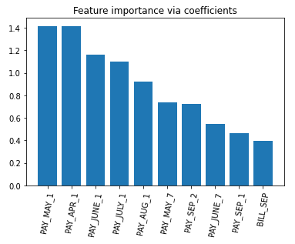
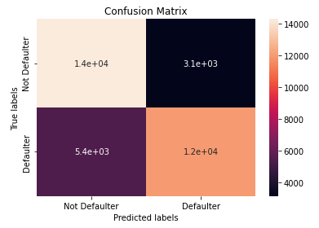
Logistic Regression(Cont.)
Feature importance refers to the techniques that assign a score to input features based on how useful they are at predicting a target variable.
From this plot we can say that PAY_MAY_1, PAY_APR_1 and PAY_JUNE_1 are the most important feature that make impact on dependent variable.

Slide 23


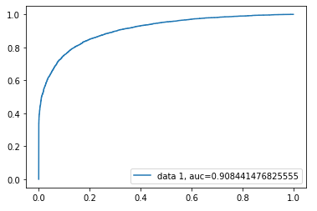
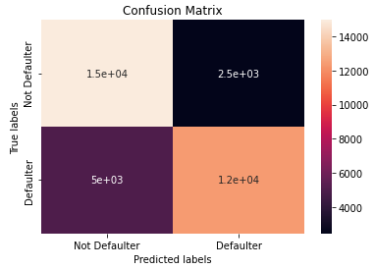
XGBoost Classifier
The XGBoost model for classification is called XGBClassifier. We can create and fit it to our training dataset. Models are fit using the scikit-learn API and the model.fit() function.
The Best Parameter is max_depth = 10 & min_child_weight = 6

Slide 24
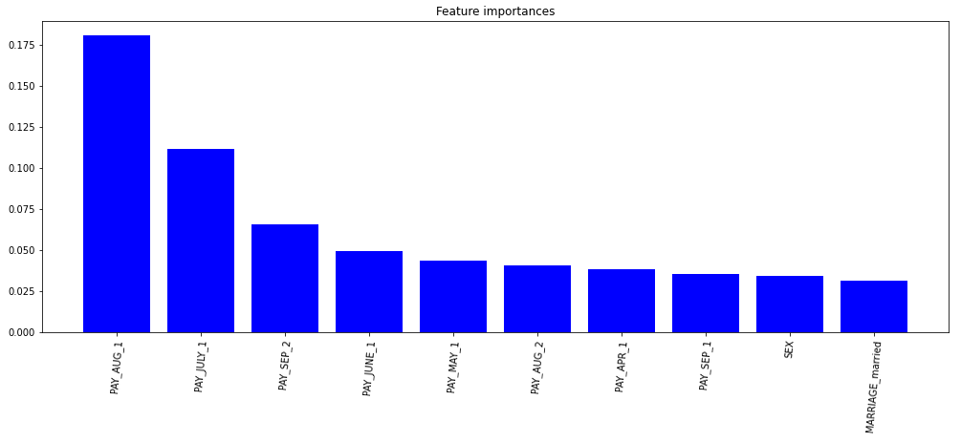
XGBoost Classifier(Cont.)
DataFrame & it’s bar plot of features_importance :-

Slide 25


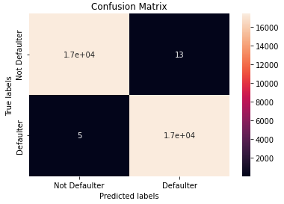
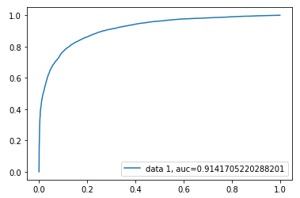
Random Forest Classifier
A random forest classifier is a meta estimator that fits a number of decision tree classifiers on various sub-samples of the dataset and uses averaging to improve the predictive accuracy and control over-fitting.
The Best Parameter is
Here, we get f1-sore approx. 82%. Since, we have
imbalanced dataset, F1- score would be a better parameter.

Slide 26
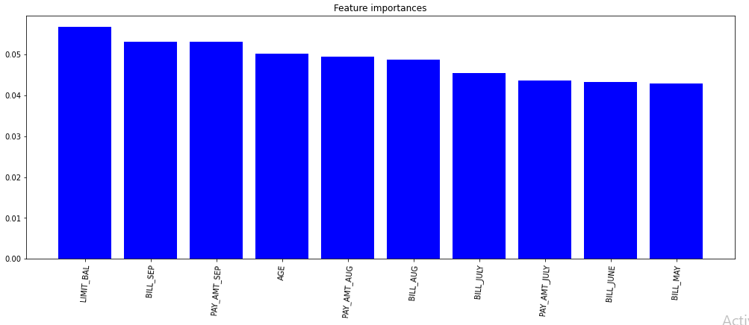
Random Forest Classifier(contd.)
From the above feature importance graph, we can say that the most important feature that make an impact on dependent variable are LIMIT_BAL and PAY_SEP.

Slide 27


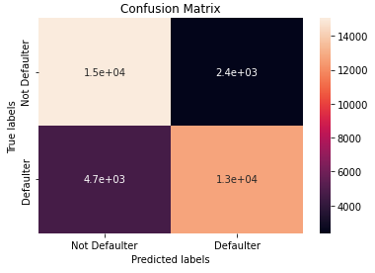
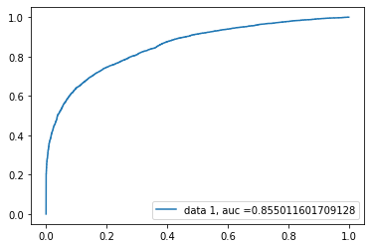
Support Vector Classifier
The Linear Support Vector Classifier (SVC) method applies a linear kernel function to perform classification and it performs well with a large number of samples. If we compare it with the SVC model, the Linear SVC has additional parameters such as penalty normalization which applies 'L1' or 'L2' and loss function.
The best parameter is

Slide 28
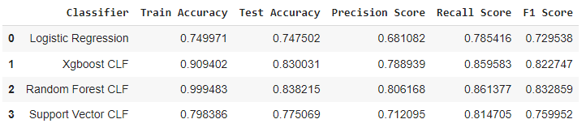
Best Model
On the basis of above Data Frame, we can say that RandomForestClassifier perform best among all of the four classifier models mentioned above.

Slide 29
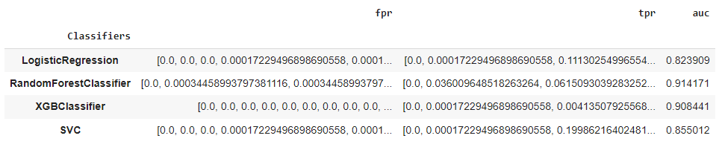
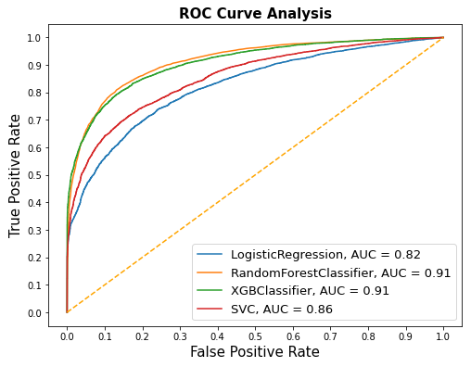
Plotting ROC AUC for all the models

Slide 30
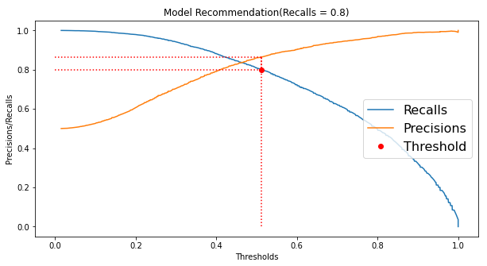
Model Recommendation
We recommend recall = 0.8, however, the threshold can be adjusted to reach higher recall.

Slide 31
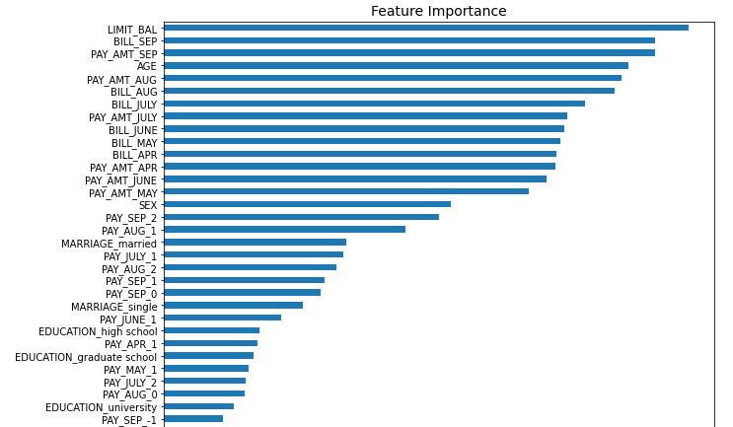
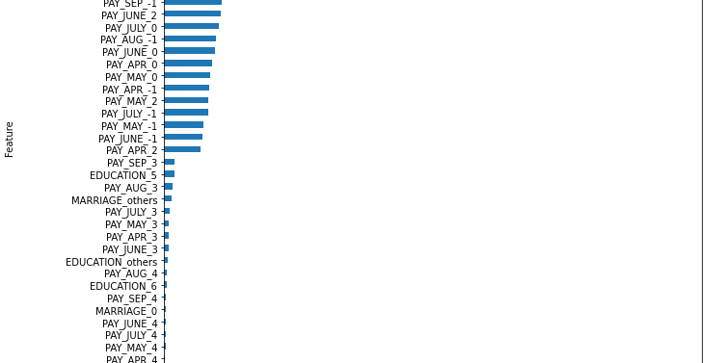
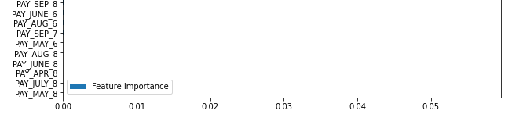
Feature Importance for recommended model
"LIMT_BAL" , "BILL_SEP" and "PAY_AMT_SEP" are the most recent 2 months payment status and they are the strongest predictors of future payment default risk.

Slide 32
Conclusion
RandomForest model and XGBoost model both has same recall, so if the business cares recall the most than both of this model are best candidate. If the balance of recall and precision is most important metric than RandomForest is the ideal model. RandomForest has recall and precision both higher than the other model applied. Hence, I would recommend RandomForest for this dataset.
Data categorical variables had minority classes which were added to their closest majority class.
There were not huge gap but female clients tended to default the most.
Labels of the data were imbalanced and had a significant difference.
Gradient boost gave the highest accuracy of 82% on test dataset.
Repayment in the month of September tended to be the most important feature for our machine learning model.
The best accuracy is obtained for the Random forest and XGBoost classifier.
In general, all models have comparable accuracy. Nevertheless, because the classes are imbalanced (the proportion of non-default credit cards is higher than default) this metric is misleading. Also, accuracy does not consider the rate of false positives (non-default credits cards that were predicted as default) and false negatives (default credit cards that were incorrectly predicted as non-default). Both cases have negative impact on the bank, since false positives leads to unsatisfied customers and false negatives leads to financial loss.
From above table we can see that XGBoost Classifier having Recall = 86%, F1-score = 82%, and ROC Score = 83% and Random forest Classifier having Recall =86%, F1-score = 83% and ROC Score = 84%.
XGBoost Classifier and RandomForest Classifier are giving us the best Recall, F1-score, and ROC Score among other algorithms. We can conclude that these two algorithms are the best to predict whether the credit card is default or not default according to our analysis on this dataset.

